Slide 1
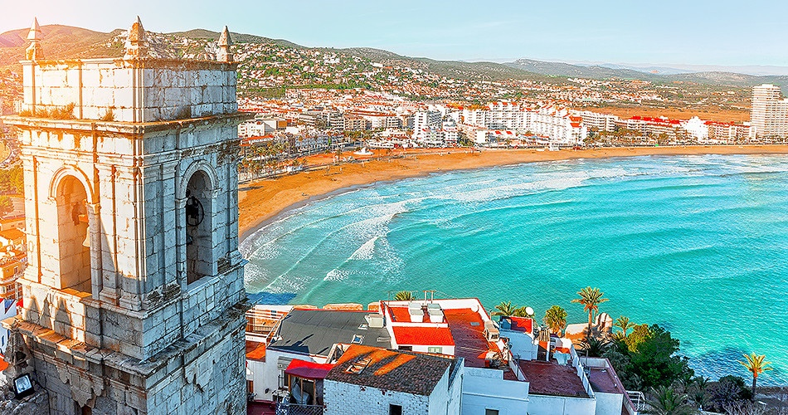
ERASMUS Valencia 2021

Slide 2
What is Erasmus?!
Erasmus is a European initiative to enable students to study or work abroad
This means we can try other educational systems, work culture and worldview
It offers great opportunities for everyone, no matter their financial situation
Typical destinations: Spain, Ireland, France…

Slide 3
What does the Erasmus to Valencia offer?
Freedom to explore and learn about other people and cultures
Chance to apply our learned skills in a real world setting and company
Three weeks long all inclusive immersive stay abroad in a foreign country

Slide 4
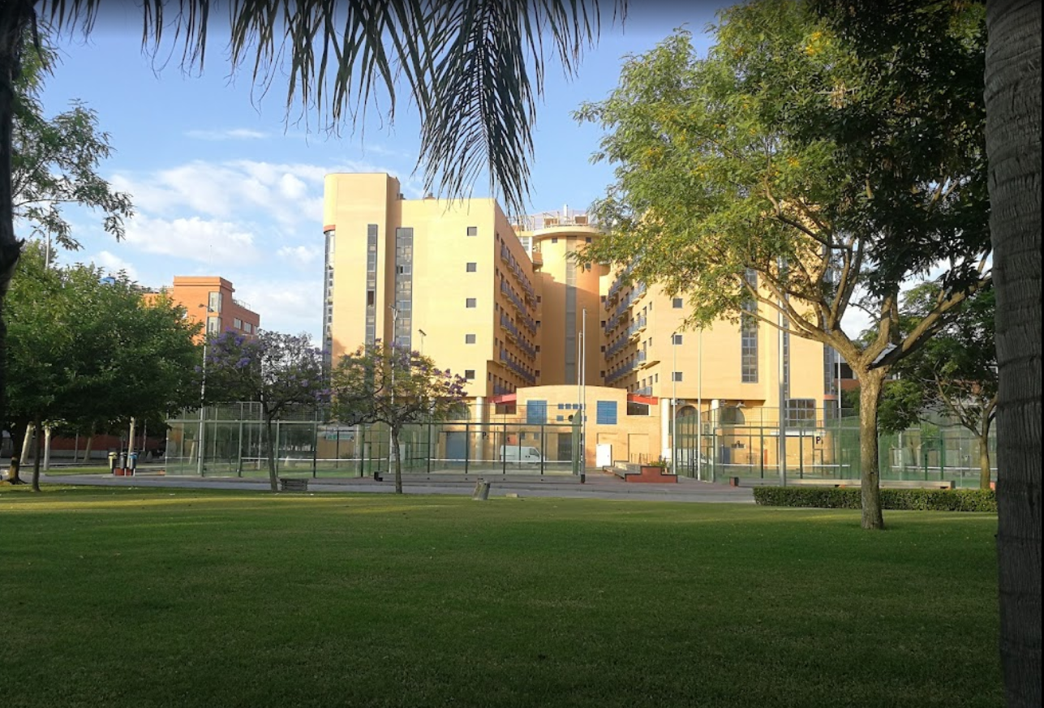
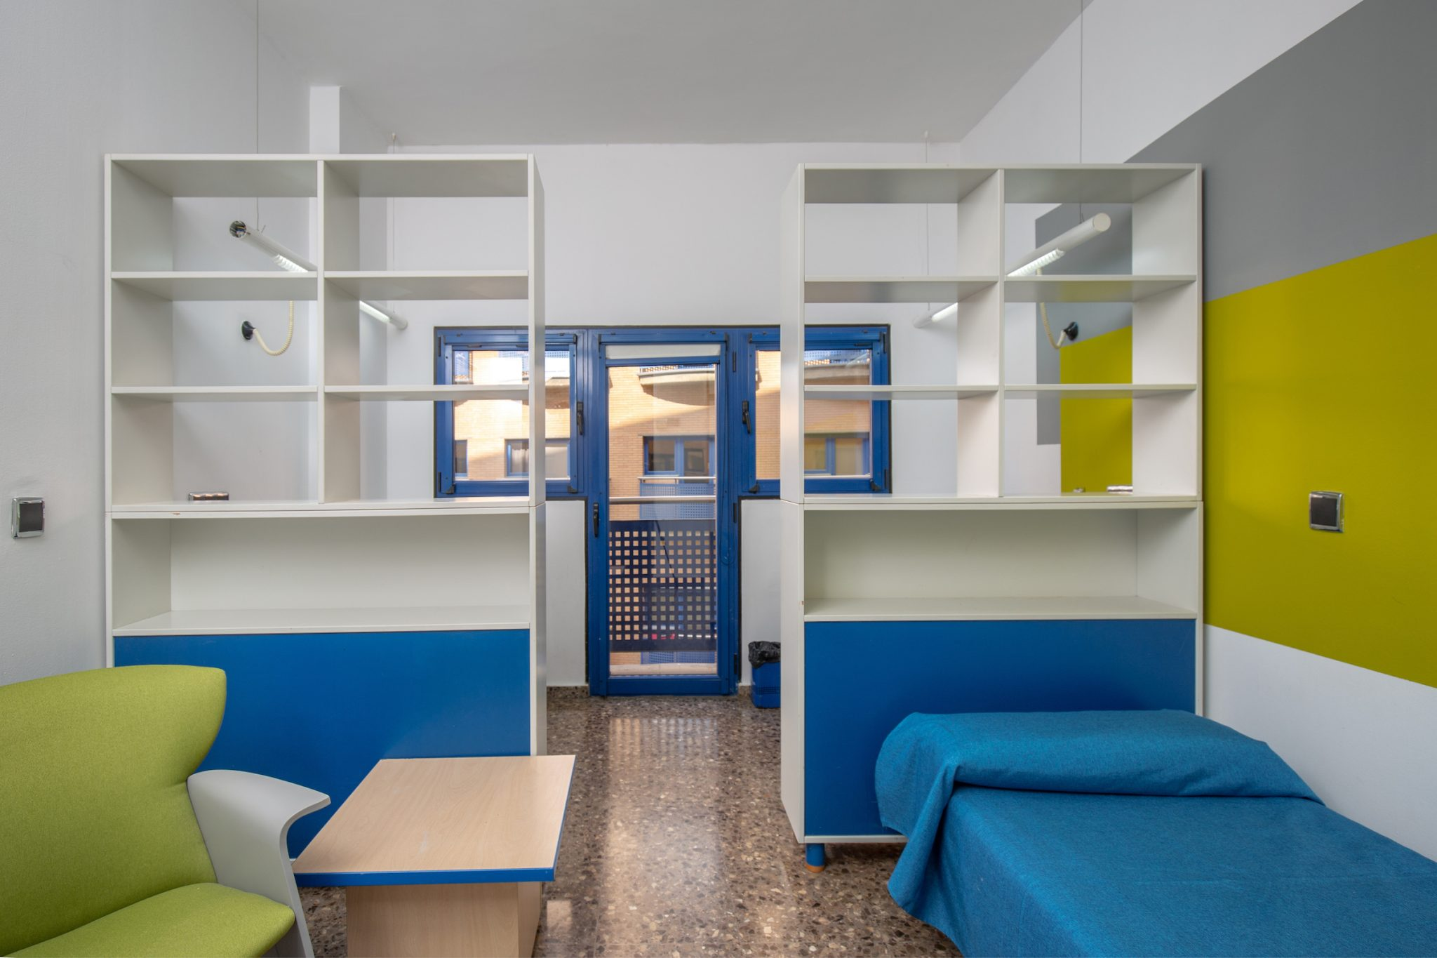
Accomodation
Galileo Galilei Building
Modern, well furnished student accomodation complex
Close to the center, surrounded by other students, fantastic atmosphere
It was possible to stay alone, in a group of two, three and four

Slide 5
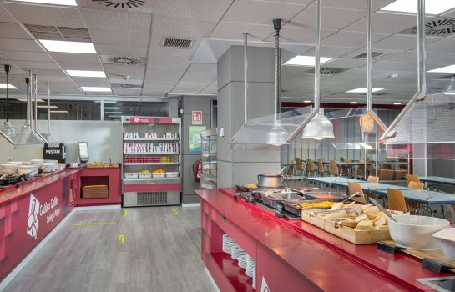
Food
Three meals per day
Wonderful all-you-can-eat type of selection
Flexible to most types of diets, alergies etc.
Great Spanish culinary quality assured

Slide 6
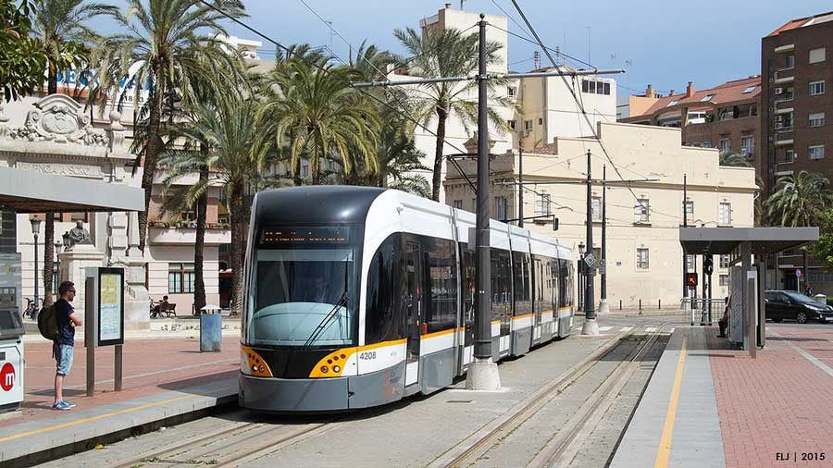
Transportation
Easy, reliable and clean transportation
Bus, train, tram
No matter where you wanted to go, it was simple and fast to get there
If traditional means of transport are not your thing, there were also electric scooters and rentable bikes everywhere

Slide 7
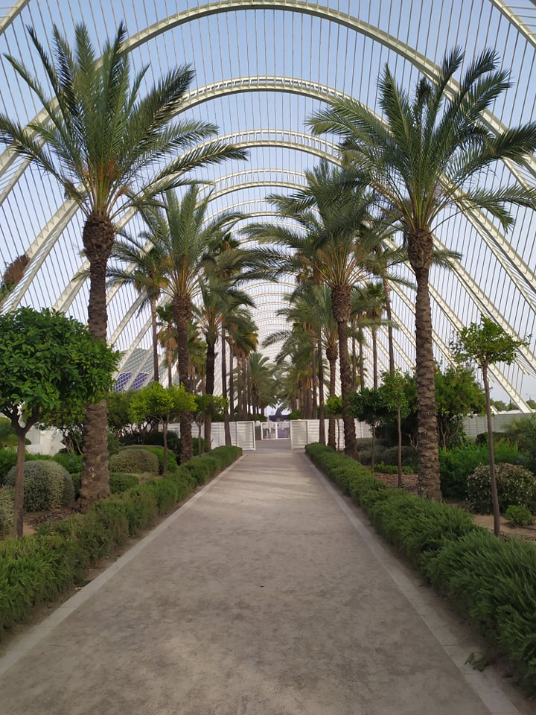
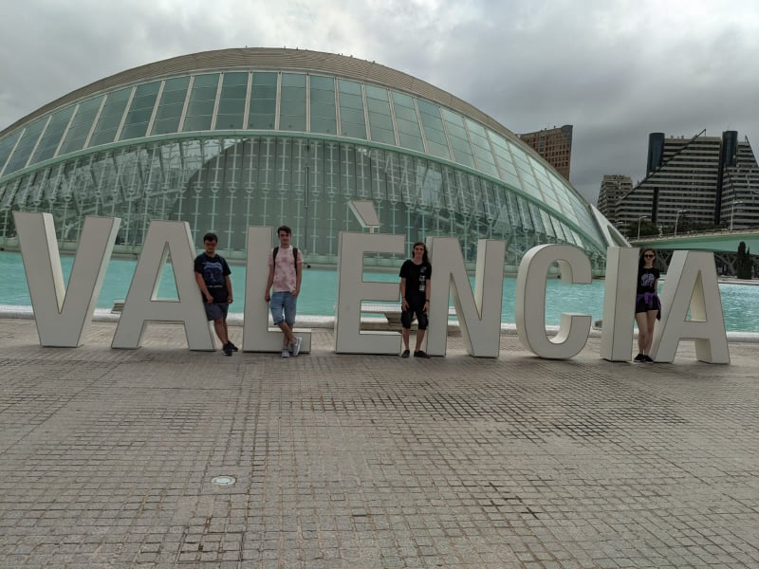
City Activities
Valencia is rich in cultural activities: historical buildings, parks to explore, tourist atractions, food, night life…
Honorable mentions: City of sciences, Bioparc, Oceanographic

Slide 8
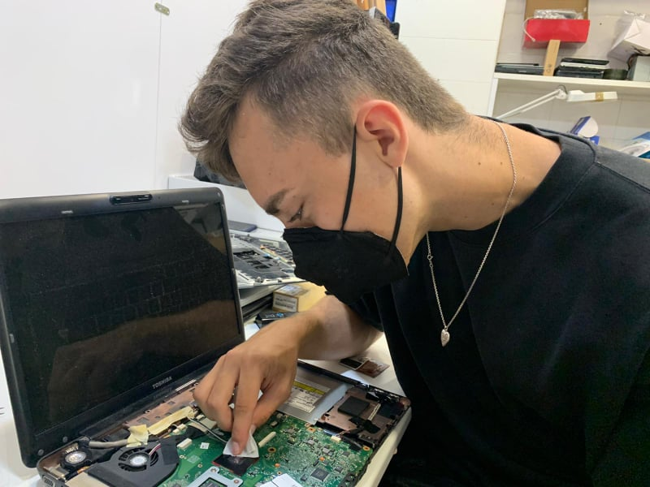
Inforlandia
IT shop
All kinds of opportunities
We repaired computers, worked with software, interacted with clients, set up dual boot, installed OS, diagnosed phone problems etc.

Slide 9
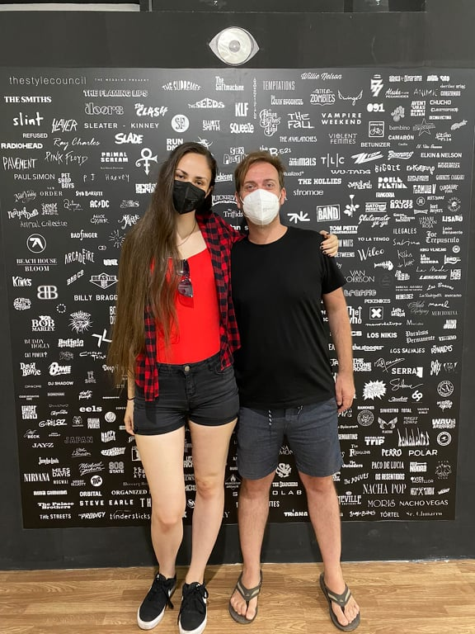
Vinyl Eye
Graphic design
Customer interaction
Advertising, marketing, product (graphical) design

Slide 10
Don’t hesitate and come try it too ;)
THE END
https://www.blue-style.cz/images/hotel/6278/Eurovikend-Valencie_Hotel-Beleret-Valencia_Pohled-na-mesto-2__w950h500_83b2ff.jpg
+ our photos ☺

